Slide 1
Representing Numbers
Notes:
To program effectively, you need to know what types of objects can hold your data and how they behave.
For example, storing numbers.
Two main ways to do this in Python, depending on the type of numbers.

Slide 2
Whole Numbers
int: A class that represents an integer
ints can be positive or negative
No limit to how large the number can be
Notes:
Example: You need to record the number of visits to your website, or how many cats a survey respondent has.
The larger the integer, the more memory the Python interpreter will allocate to store it.
The ultimate limit is the amount of memory on your computer.

Slide 3
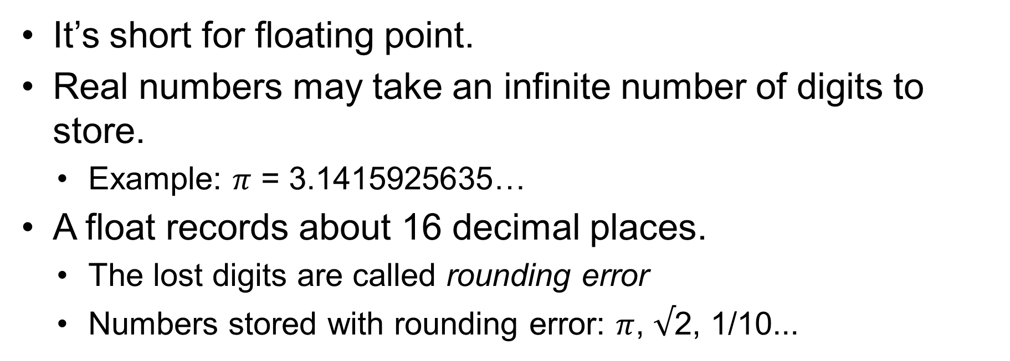
Non-Integer Numbers
float: A class that represents a real number
Notes:
Example: you need to record the fraction of jellybeans that is red, or 1/2, or π.

Slide 4
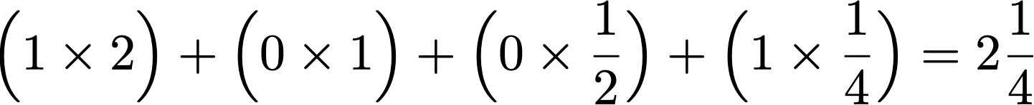
Binary Representation of Numbers
10.01
Twos
Ones
Halves
Quarters
In binary, 1/10 is written 1.00011001100110011001100110011…
Cannot be stored without rounding error
Lesson: avoid checking if floats are exactly equal
Notes:
Rounding errors can occur even when you’re not expecting them. That’s because under the hood, all numbers in a computer are stored in binary.

Slide 5
Representing Numbers

